Slide 1

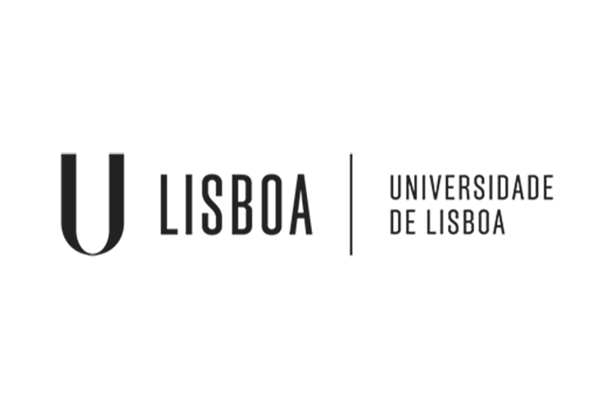
PhD Open Days 2020
Poster
Notes:
At the PhD Open Days 2020 event...

Slide 2





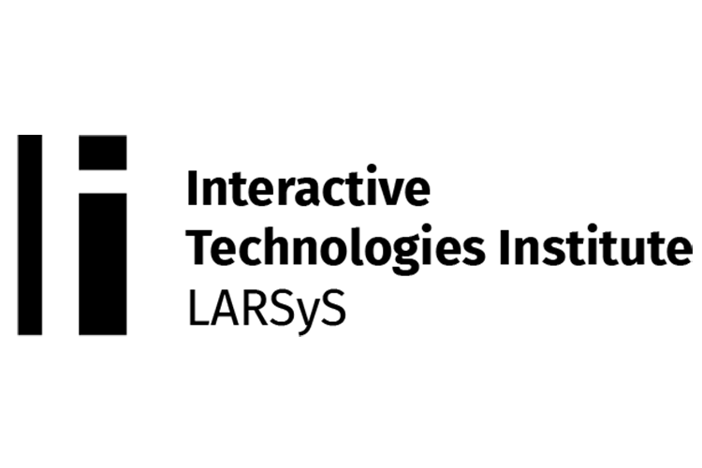
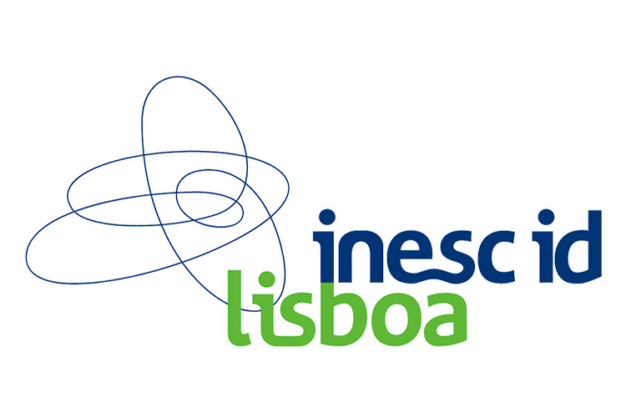

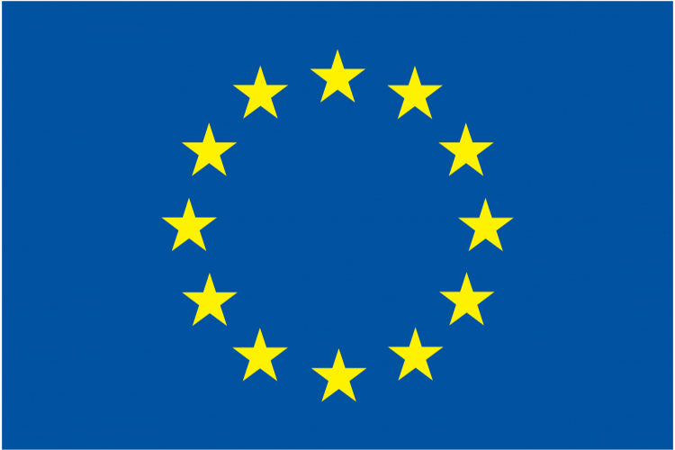
Medical Imaging Multimodality Annotating Framework
Francisco Maria Calisto, 2020. Medical Imaging Multimodality Annotating Framework. ResearchGate. (2020).
DOI: https://doi.org/10.13140/RG.2.2.16086.88649
Notes:
… we are presenting the poster titled as “Medical Imaging Multimodality Annotating Framework”, a multimodality framework for annotating medical images.

Slide 3
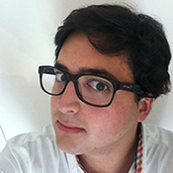
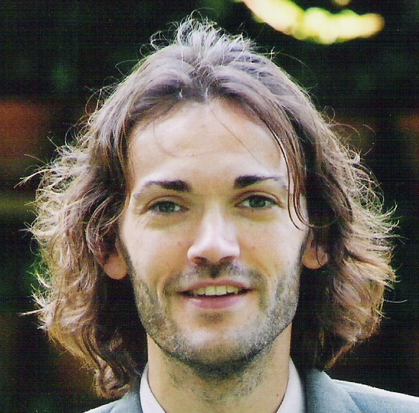
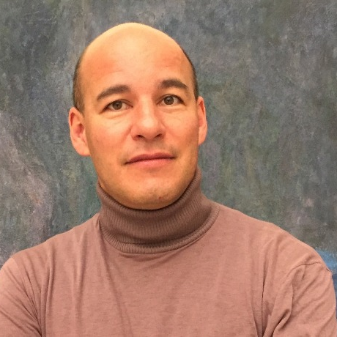
Author & Advisors
Francisco M. Calisto
(Author)
ISR-Lisboa
Instituto Superior Técnico
Universidade de Lisboa
Jacinto C. Nascimento
(Advisor)
ISR-Lisboa
Instituto Superior Técnico
Universidade de Lisboa
Nuno Nunes
(Co-Advisor)
ITI
Instituto Superior Técnico
Universidade de Lisboa
Notes:
Author & Advisors...

Slide 4
Motivation
1.
Why Cancer? Why Medical Imaging?
Notes:
Why cancer? Why medical imaging?

Slide 5
Early
Detection
Cancer mortality can be reduced if cases are detected and treated early.
Notes:
The cancer burden can be reduced through early detection of cancer and management of patients who develop cancer. Cancer mortality can be reduced if cases are detected and treated early.

Slide 6
HCI in Healthcare
2.
Diagnostic systems have also been studied under the HCI field.
Notes:
Several diagnostic systems have been studied under the Human-Computer Interaction field.

Slide 7
HCI in Healthcare
Supporting the image search UX through novel UIs [1, 2]
Medical imaging technologies to support radiologists [3]
Systems that assist radiologists in image interpretation [4, 5]
1 Koutsabasis, P. and Domouzis, C.K., 2016, June. Mid-air browsing and selection in image collections. In Proceedings of the International Working Conference on Advanced Visual Interfaces (pp. 21-27).
2 Lee, B., Srinivasan, A., Stasko, J., Tory, M. and Setlur, V., 2018, May. Multimodal interaction for data visualization. In Proceedings of the 2018 International Conference on Advanced Visual Interfaces (pp. 1-3).
3 Woźniak, P., Romanowski, A., Yantaç, A.E. and Fjeld, M., 2014, October. Notes from the front lines: lessons learnt from designing for improving medical imaging data sharing. In Proceedings of the 8th Nordic Conference on Human-Computer Interaction: Fun, Fast, Foundational (pp. 381-390).
4 Cai, C.J., Winter, S., Steiner, D., Wilcox, L. and Terry, M., 2019. " Hello AI": Uncovering the Onboarding Needs of Medical Practitioners for Human-AI Collaborative Decision-Making. Proceedings of the ACM on Human-computer Interaction, 3 (CSCW), pp.1-24.
5 Oram, L., MacLean, K., Kruchten, P. and Forster, B., 2014, June. Crafting diversity in radiology image stack scrolling: control and annotations. In Proceedings of the 2014 conference on Designing interactive systems (pp. 567-576).
Notes:
There are a large amount of publications in the field of HCI. However, our solution is different from previously works. Namely, two issues highlight our proposal. First, the use of multimodal images in breast diagnosis. Second, the possibility to provide radiologists to have the annotations in all modalities.

Slide 8
Medical Imaging
3.
How to improve and support medical imaging?
Notes:
How to improve and support medical imaging?

Slide 9
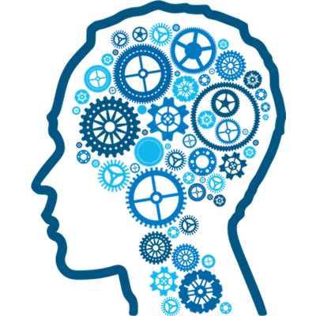
Healthcare Systems
Machines that can learn with new data from clinicians’ experience.
Notes:
An available dataset is extremely important since recently there are a bunch of machine learning algorithms that use rich annotation datasets. With this framework, the machine learning community is able to provide new data to the algorithms.

Slide 10
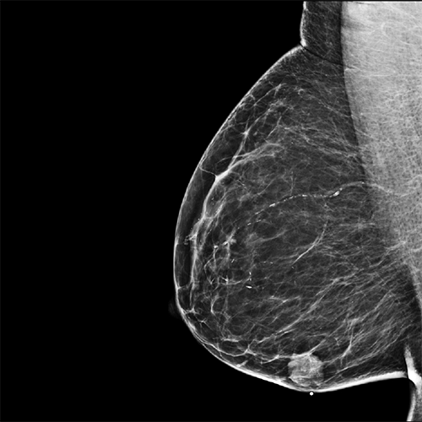
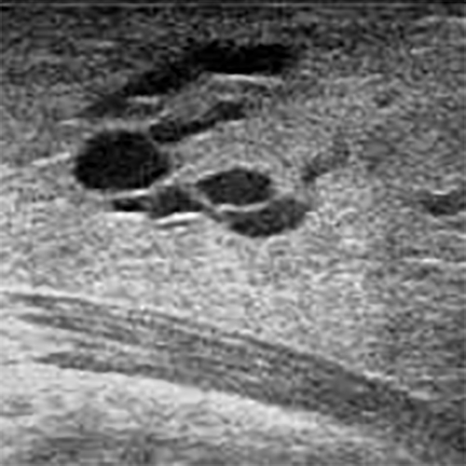
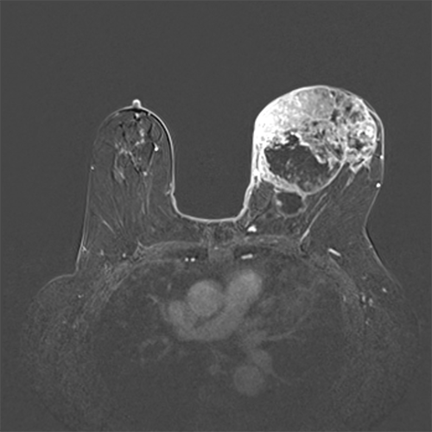
Multimodality Annotating Framework
MammoGraphy (MG)
UltraSound (US)
Magnetic Resonance Imaging (MRI)
+
+
Notes:
You may wonder: why multimodality is important? Because there are two situations: (1) when we have adipose tissue, we just need MG; however, (2) when the tissue is dense, MG is not enough for a proper diagnosis, so it is imperative the use of a multimodality strategy. In this case, for dense breast, MG, US and MRI. Sometimes, clinicians perform a kind of loop for the inspection of lesions. It is why is very important to have some similar proposal as we do in this work.

Slide 11
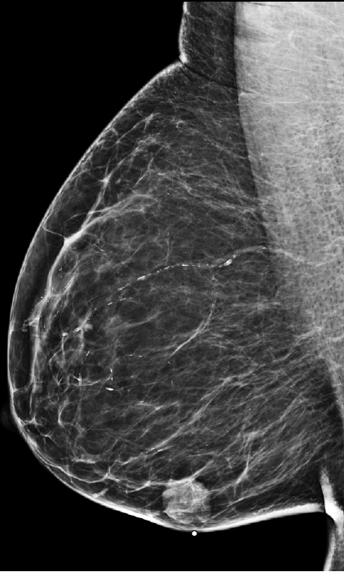
Medical Annotations
Notes:
There are two types of lesions...

Slide 12
Medical Annotations
Masses
Notes:
There are masses, with small contours of the tissue.

Slide 13
Medical Annotations
Microcalcifications
Notes:
And there are microcalcifications which are little points on the tissue.

Slide 14
Multimodality Annotating Framework
MammoGraphy (MG)
UltraSound (US)
Magnetic Resonance Imaging (MRI)
>
>
Lesions
Notes:
So we want to collect this information. These are some examples of mass on MG, US and MRI. And we aim to locate and to store this information in our dataset.

Slide 15
BreastScreening
4.
A medical imaging visualization framework to be evaluated
in a realistic clinical scenario.
Notes:
To validate the proposed design goals, we created BreastScreening, as a medical imaging visualization framework.

Slide 16
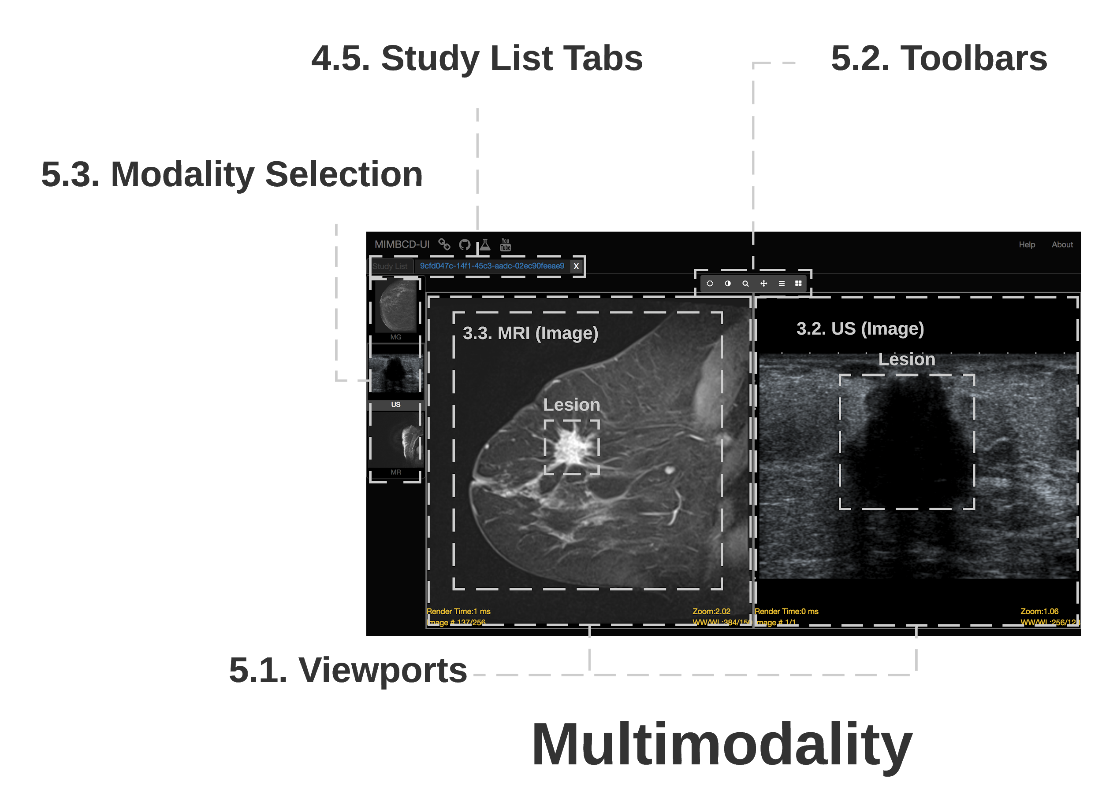
User Interface
Notes:
The User Interface (UI) consists of two main components...

Slide 17
User Interface
Notes:
4. List of Patient Views. where we have a 4.5 Study List of patients that the interface includes on the top left corner.

Slide 18
User Interface
Notes:
And also the 5. Medical Imaging Diagnosis Views. In this case, we have the 5.1. Viewports where clinicians can interact with MG, US and MRI using a set of features according to the 5.2. Toolbars. Finally, clinicians can change the respective modality on the 5.3. Modality Selection freely.

Slide 19
Medical Annotations
5.
Lesion annotations among the breast cancer disease.
Notes:
Lesion annotations among the breast cancer disease.

Slide 20
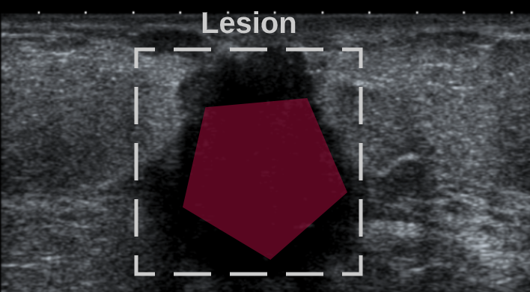
Image Segmentation
Notes:
Medical image segmentation is the process of manually draw for boundaries within our various modalities of images. The goal of the clinician is to annotate the lesion between the red polygon and the dashed gray square.

Slide 21
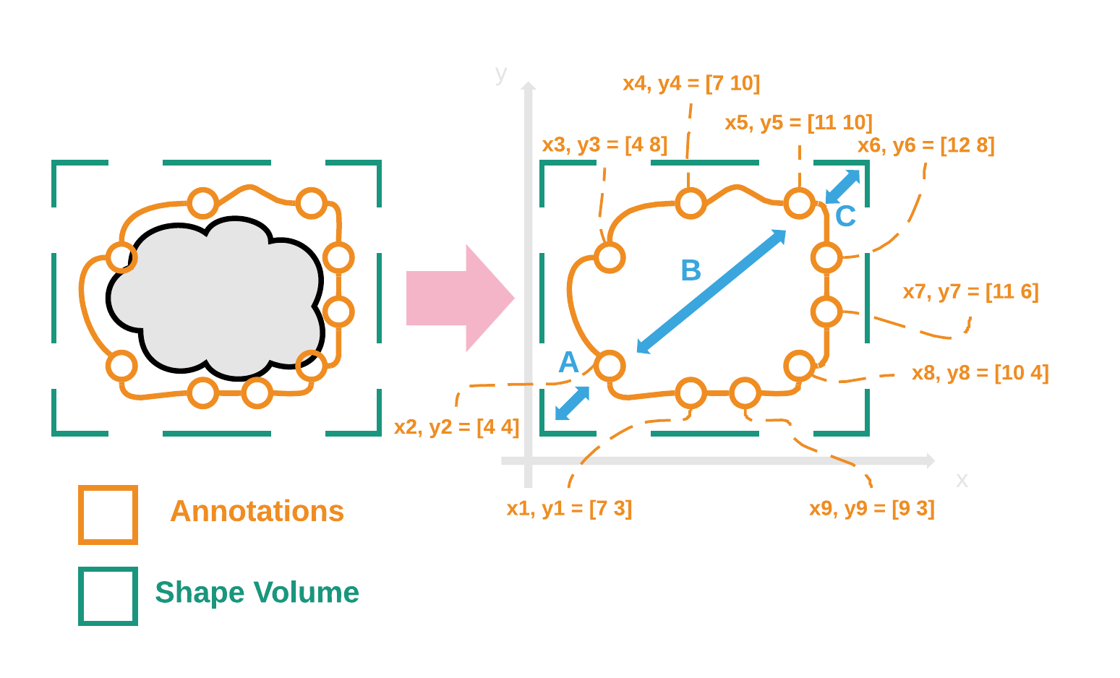
Lesion Labels
Notes:
Manual annotations are very useful to extract features like contours, intersections, shapes and image patterns. With this, we can measure the ground-truth of the lesion and give this information to the ML algorithms.

Slide 22
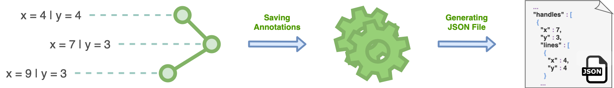
Dataset Generation
Notes:
Our solution, will enable machine learning communities to organize and promote medical imaging projects. As result of our generated dataset, the community can now have access to a tool, creating their own datasets of medical images and annotations, respectively.

Slide 23
Conclusion
6.
The contributions and conclusions of our work.
Notes:
The contributions and conclusions of our work are as follows...

Slide 24
Contributions & Conclusions
New medical imaging framework supported by an interactive UI;
Development of a framework to generate a standardized dataset of medical imaging annotations;
Providing clinicians a novel tool for the production of several qualified datasets;
Fostering clinicians' sharing and collaborative diagnostic by developing a distributed and remote framework;
Notes:
In this presentation, it is proposed a new medical imaging framework supported by an interactive UI. More precisely, the development of a framework to generate a standardized dataset of medical imaging annotations. Across the domain of breast cancer, we adopt a multimodality visualization strategy (i.e., MG, US and MRI) in order to provide clinicians a tool for the production of those qualified datasets. In the end, we foster clinicians' sharing and collaborative evaluation by developing a distributed, as well as a remote accessible framework.

Slide 25
Thank you!
Notes:
Thank you!

Slide 26

Information
Francisco Maria Calisto
E-Mail: francisco.calisto@tecnico.ulisboa.pt
Academic Webpage: web.tecnico.ulisboa.pt/francisco.calisto
Lab Webpage: welcome.isr.tecnico.ulisboa.pt
Notes:
Francisco Maria Calisto

Slide 27
The paradigm shift of the ImageNet thinking is that while a lot of people are paying attention to models, let's pay attention to data. Data will redefine how we think about models.
Li Fei-Fei
Notes:
“The paradigm shift of the ImageNet thinking is that while a lot of people are paying attention to models, let's pay attention to data. Data will redefine how we think about models.”
- Li Fei-Fei

